Slide 1
COVID-19 vaccins – July 5, 2022
Pierre Van Damme, MD PhD
Vaccin- en Infectieziekten Instituut (UAntwerpen)
Centrum voor de Evaluatie van Vaccinaties

Slide 4
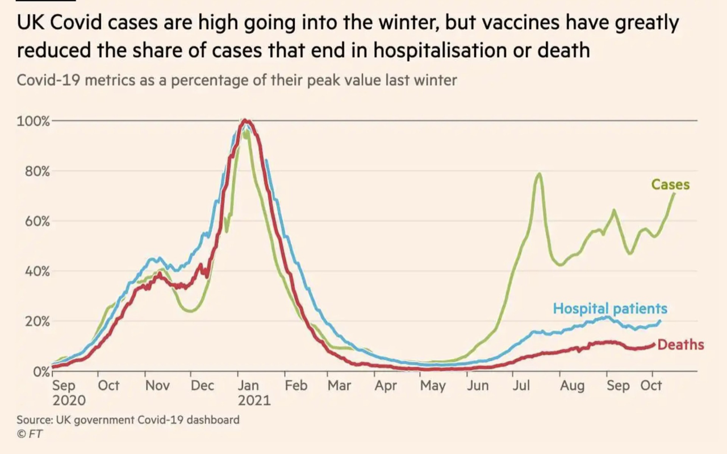

Slide 7
1° booster?

Slide 8
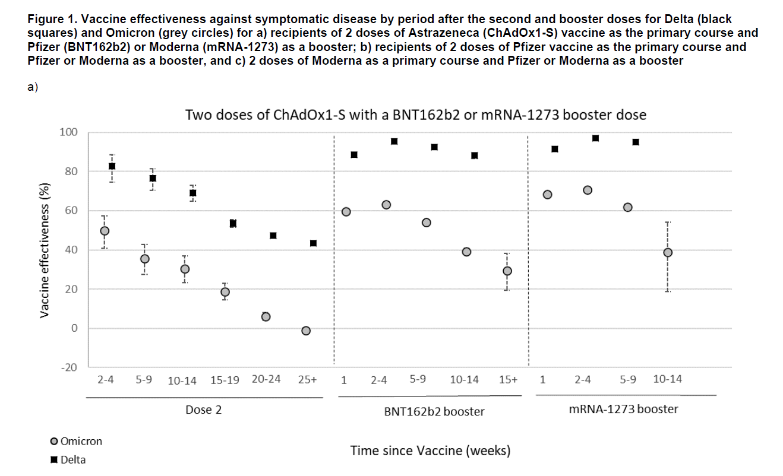
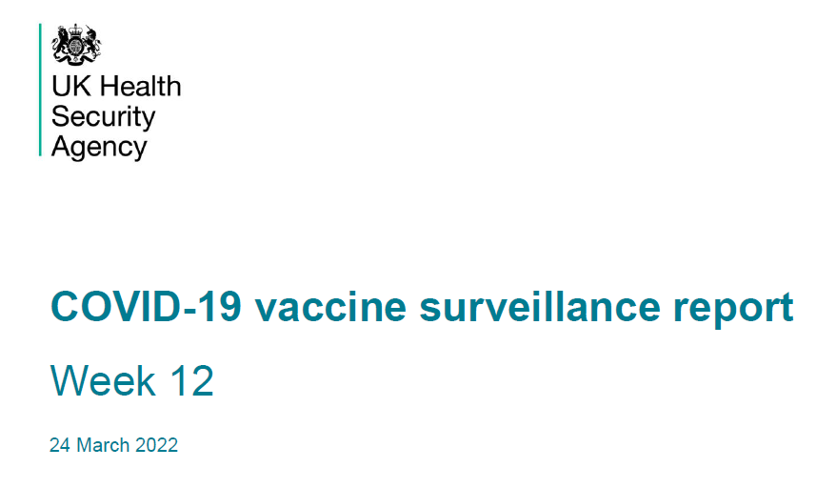

Slide 9
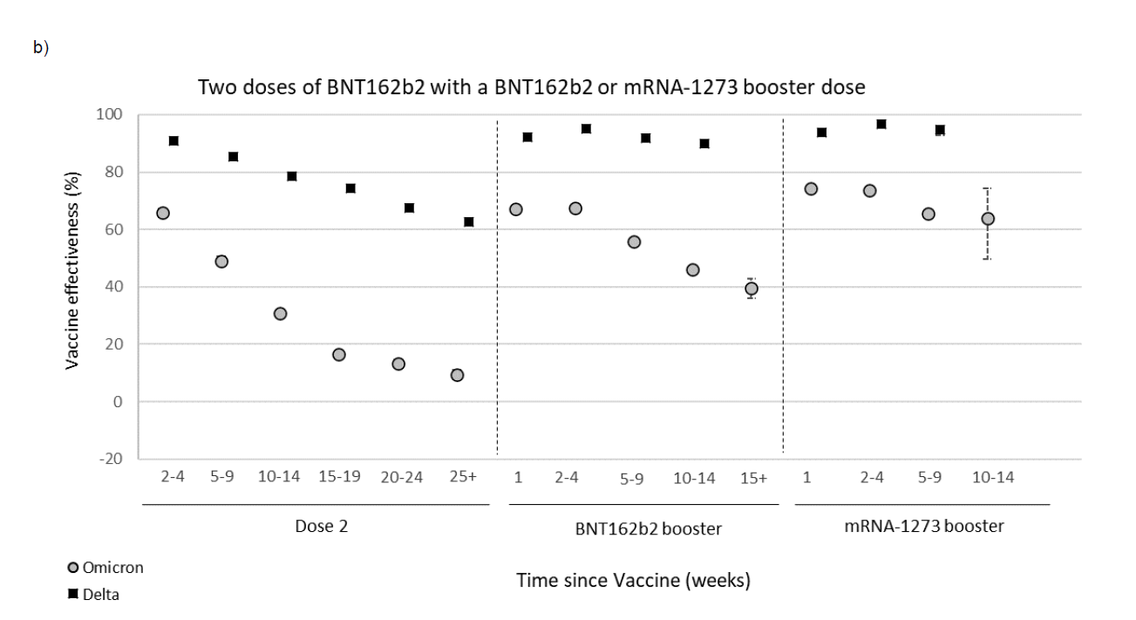

Slide 10
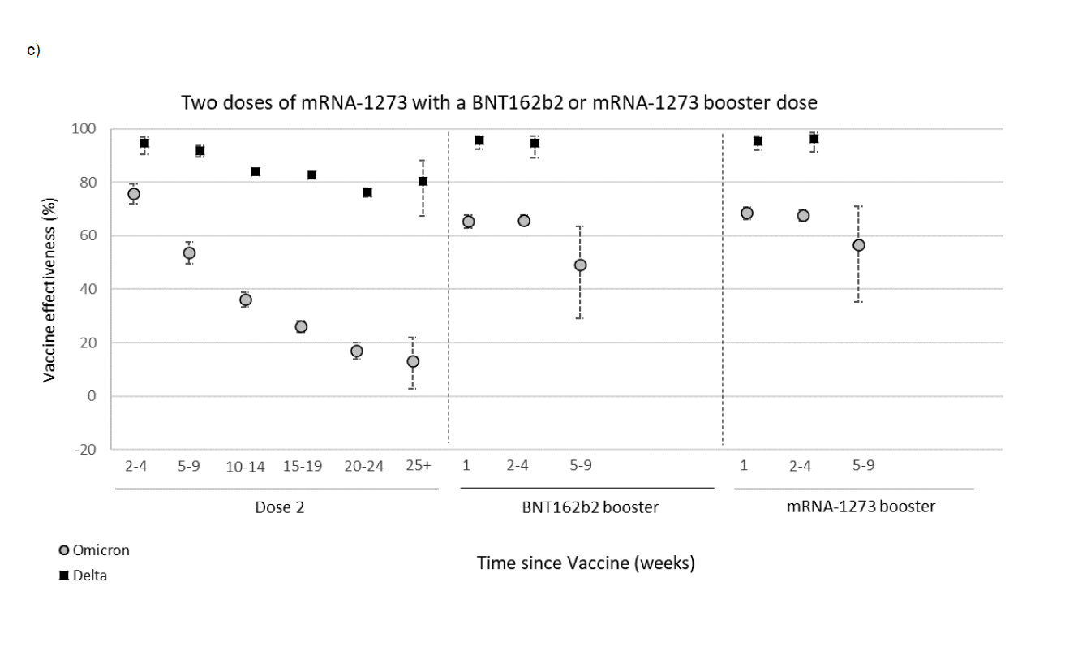

Slide 13
Nederland, 18 jan 2022

Slide 14
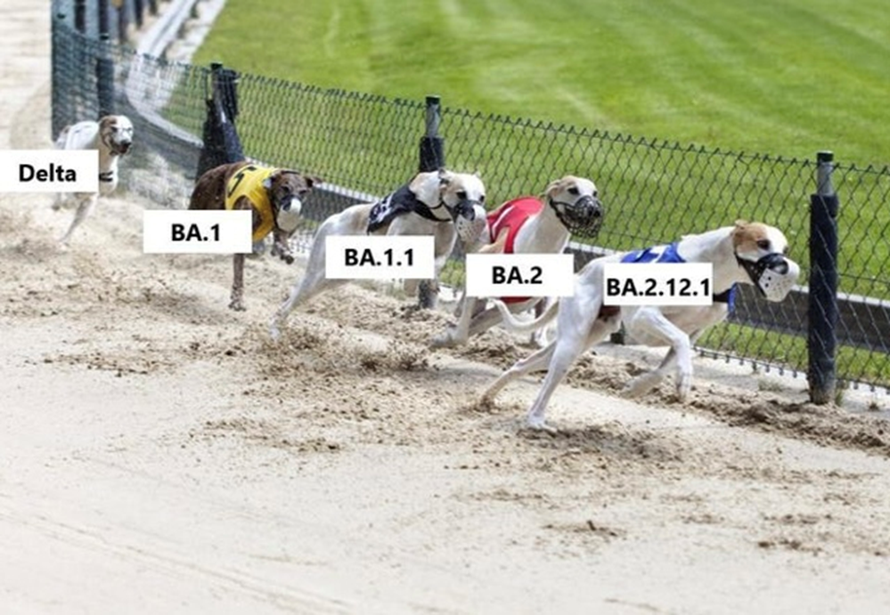

Slide 15
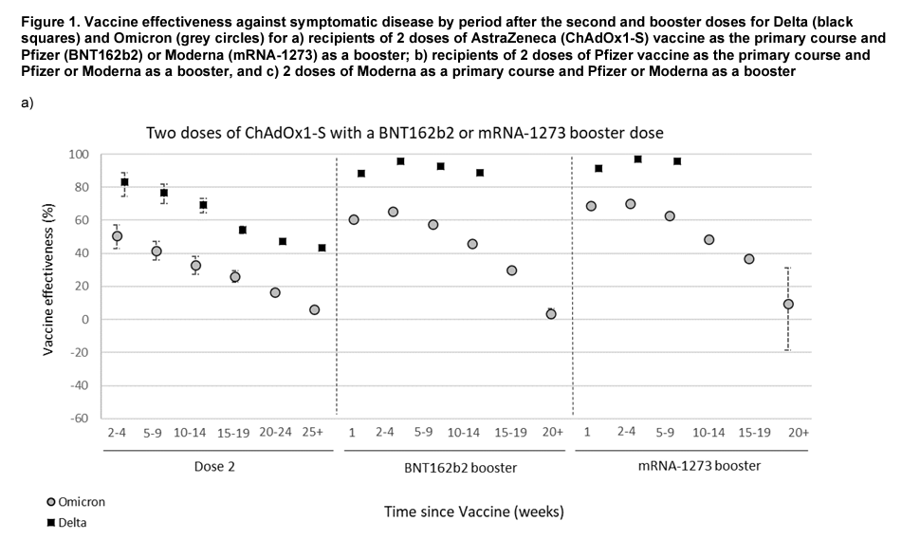

Slide 16
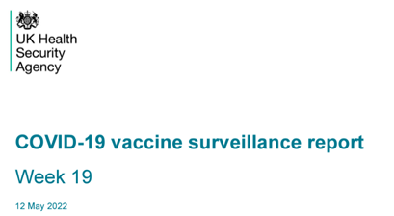

Slide 18
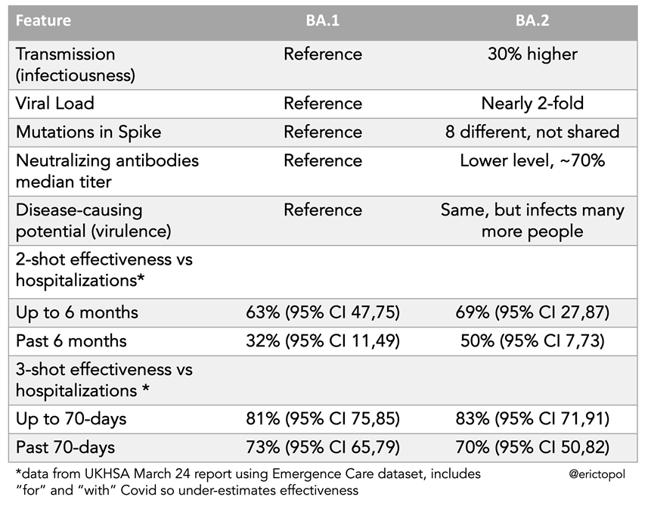

Slide 20
2° booster?

Slide 24
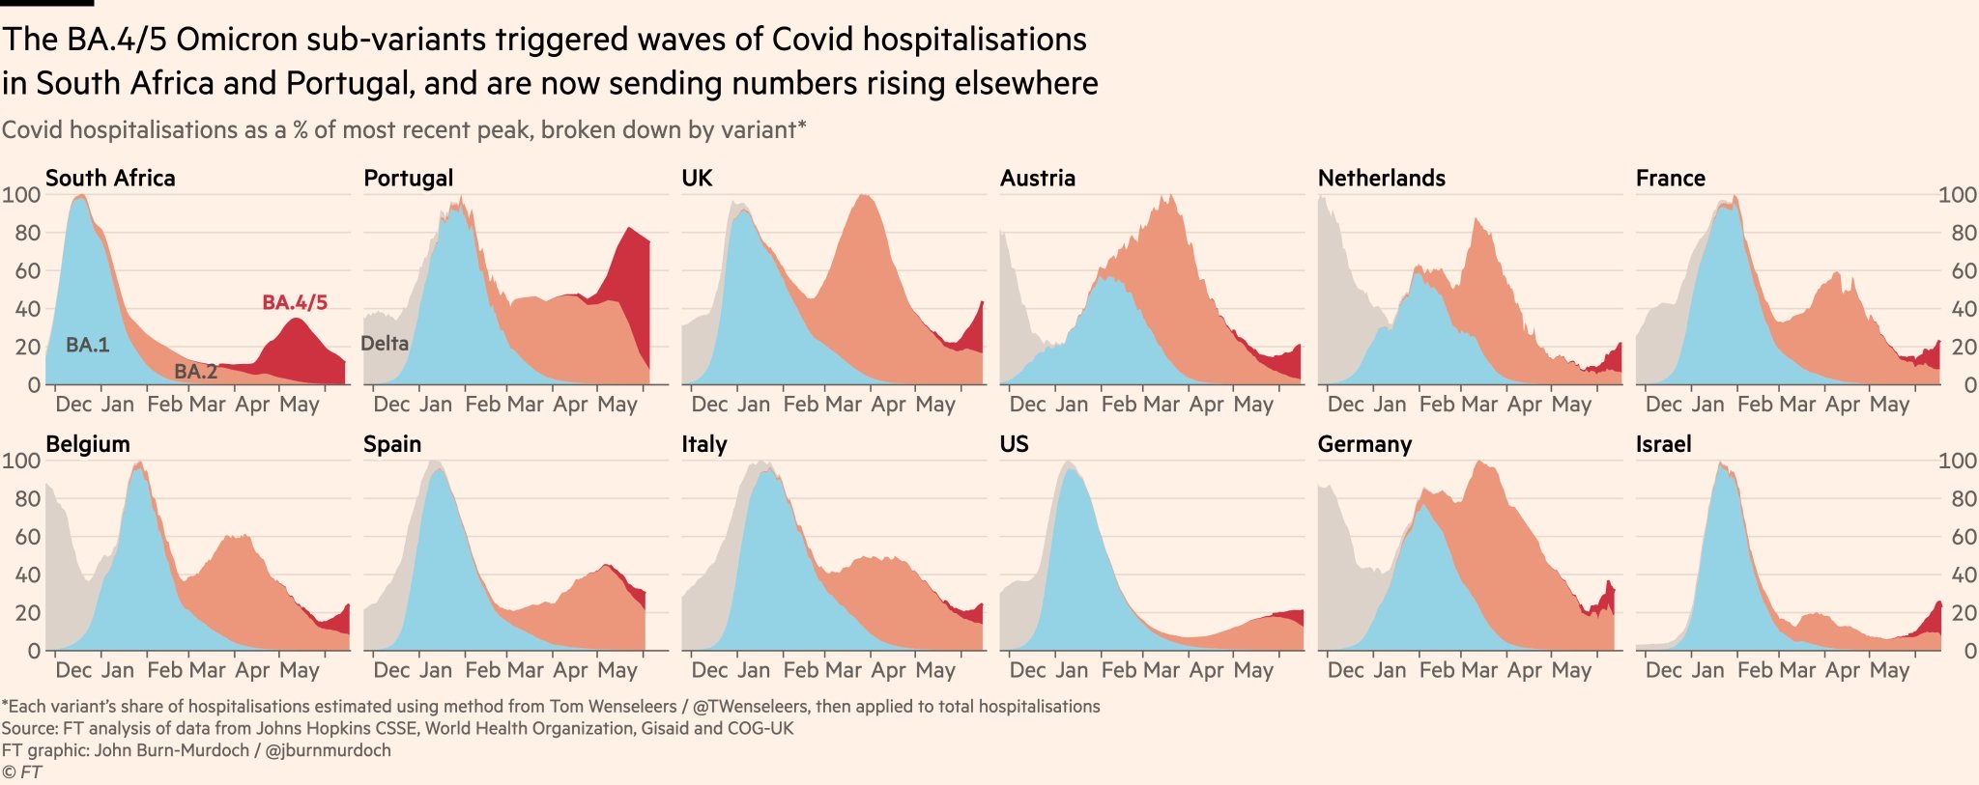
FT, end of June 2022

Slide 25
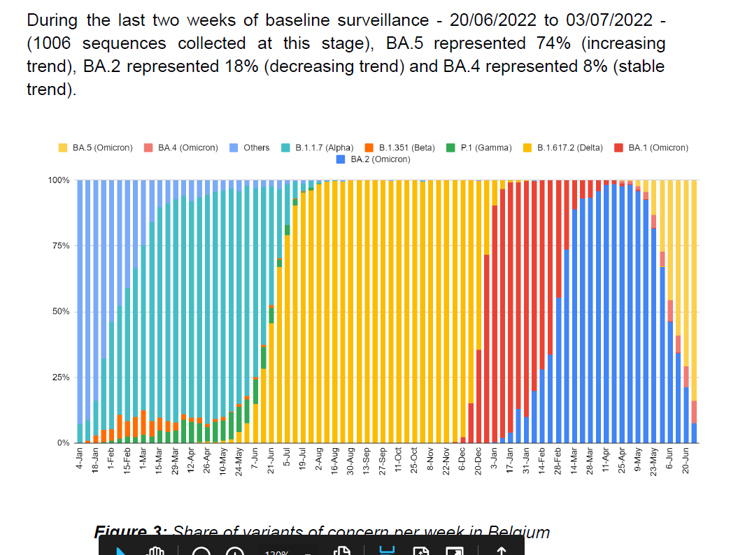
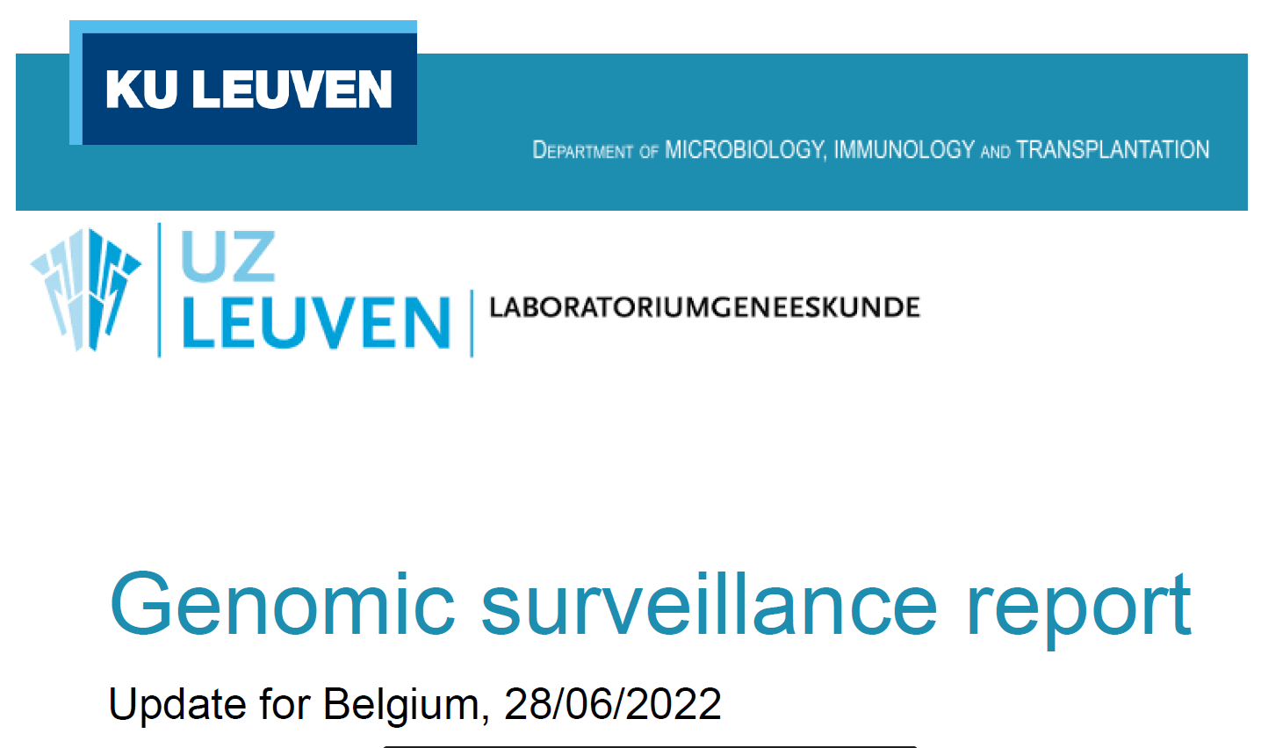

Slide 26
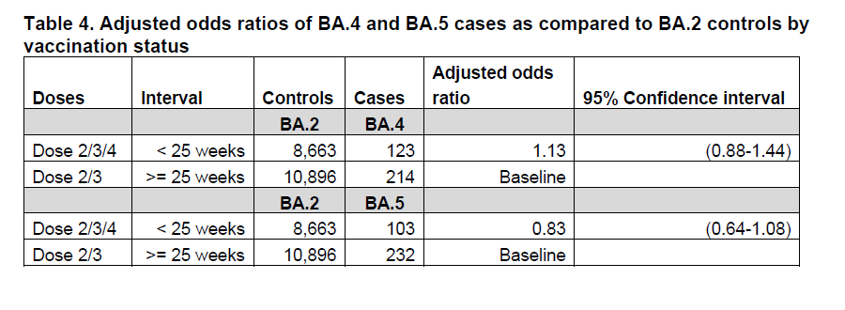
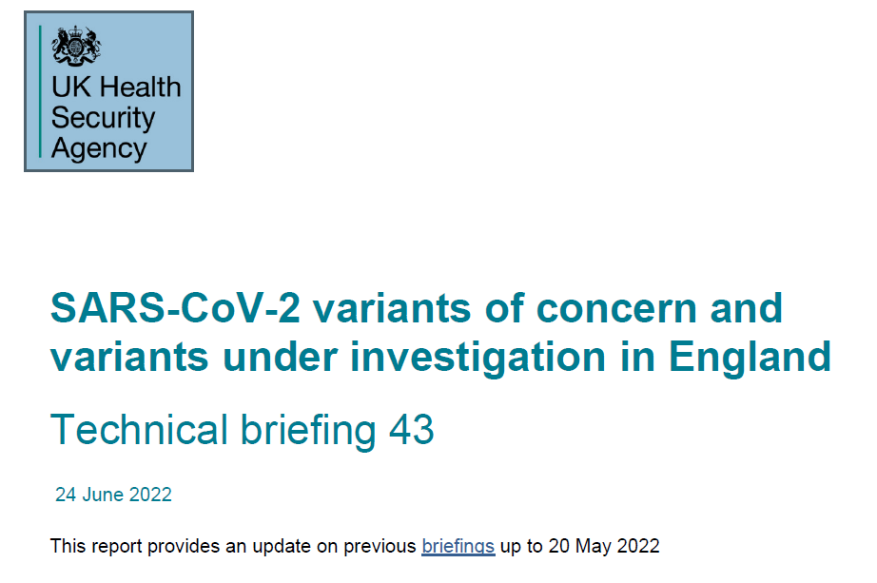

Slide 27
What should we do?
Extend 2° booster to a larger part of the population?
When?
September 2022:
with monovalent BA1-Omicron-tailored or bi-valent (Wuhan-BA1 Omicron) vaccine
Might confer broader immunity also to novel variant
Protection is waning
No immediate safety issues with 2nd booster
Interval since last vaccination increases
COVID-19 continues to circulate
Precautionary measure?

Slide 28
One month after administration, a booster dose of the Omicron-adapted monovalent candidates (30 μg and 60 μg) increased neutralizing geometric mean titers (GMT) against Omicron BA.1 13.5 and 19.6-fold above pre-booster dose levels, while a booster dose of the Omicron-adapted bivalent candidates conferred a 9.1 and 10.9-fold increase in neutralizing GMTs against Omicron BA.1. Both Omicron-adapted vaccine candidates were well-tolerated in participants who received one or the other Omicron-adapted vaccine.
In a SARS-CoV-2 live virus neutralization assay tested on sera from participants over 56 years of age and older, sera efficiently neutralized BA.4/BA.5 with titers approximately 3-fold lower than BA.1. Pfizer and BioNTech will continue to collect additional study data on Omicron BA.4/BA.5 over the coming weeks.

Slide 29
The future beyond next winter?
Decisions for updating vaccine strains : manufacturers versus WHO!
Co-administration with influenza vaccines
Multivalent vaccines/adapted vaccines
BA1 variant vaccine – Wuhan/BA1 bivalent vaccine
Intradermal vaccines (dose-sparing)
Intra-nasal vaccines (mucosal immunity)
Pan-corona vaccines

